Slide 1
CPU Fundamental
Unit 4

Slide 2
4.1 CPU Organization /Structure
4.2 Register Organization and data path .

Slide 3
Central Processing Unit (CPU)
The full form of CPU is Central Processing Unit .
It is a brain of the computer.
It helps input and output devices to communicate with each other and perform their respective operations.
stores data which is input, intermediate results in between processing, and instructions.

Slide 4
What is a CPU?
A Central Processing Unit is the most important component of a computer system.
A CPU is a hardware that performs data input/output, processing and storage functions for a computer system.
A CPU can be installed into a CPU socket.
These sockets are generally located on the motherboard.
CPU can perform various data processing operations.
CPU can store data, instructions, programs, and intermediate results.

Slide 5
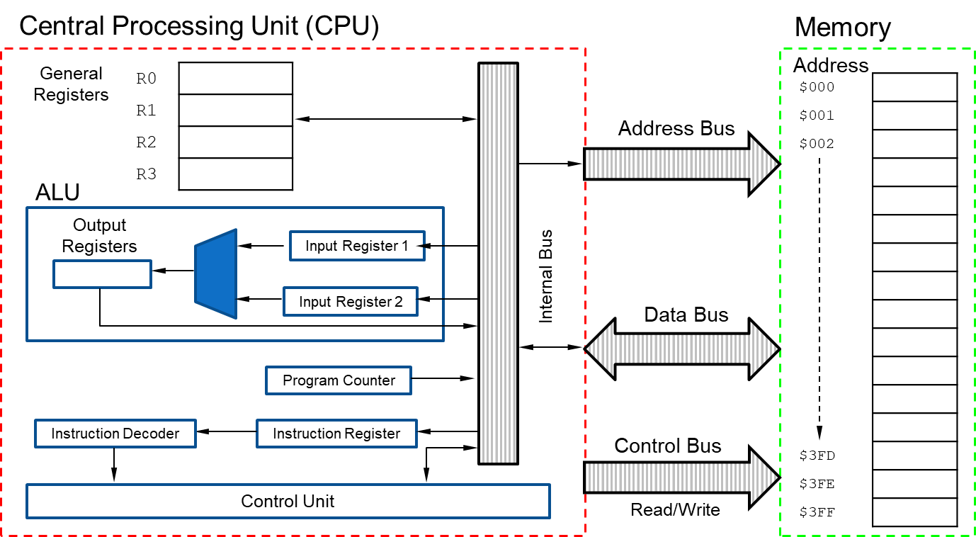
Different Parts of CPU( CPU Organization )
Now, the CPU consists of 3 major units, which are:
Memory or Storage Unit
Control Unit
ALU(Arithmetic Logic Unit)

Slide 6
Memory or Storage Unit
It unit can store instructions, data, and intermediate results.
The memory unit is responsible for transferring information to other units.
It is also known as an internal storage unit or the main memory or the primary storage or Random Access Memory (RAM) as all these are storage devices.
Its size affects speed, power, and performance.
There are two types of memory in the computer,
Primary memory and
Secondary memory.
Some main functions of memory units are listed below:
Data and instructions are stored in memory units which are required for processing.
It also stores the intermediate results of any calculation or task when they are in process.
The final results of processing are stored in the memory units before these results are released to an output device for giving the output to the user.
All sorts of inputs and outputs are transmitted through the memory unit.

Slide 7
Control Unit
Control unit controls the operations of all parts of the computer but it does not carry out any data processing operations.
It takes instructions from the memory unit and then decodes the instructions after that it executes those instructions.
So, it controls the functioning of the computer.
It’s main task is to maintain the flow of information across the processor.
Some main functions of the control unit are listed below:
Controlling of data and transfer of data and instructions is done by the control unit among other parts of the computer.
The control unit is responsible for managing all the units of the computer.
The main task of the control unit is to obtain the instructions or data which is input from the memory unit, interprets them, and then directs the operation of the computer according to that.
The control unit is responsible for communication with Input and output devices for the transfer of data or results from memory.
The control unit is not responsible for the processing of data or storing data.

Slide 8
ALU (Arithmetic Logic Unit)
ALU (Arithmetic Logic Unit) is responsible for performing arithmetic and logical functions or operations.
It consists of two subsections, which are:
Arithmetic Section
Logic Section
Arithmetic Section: By arithmetic operations, we mean operations like addition, subtraction, multiplication, and division, and all these operation and functions are performed by ALU.
Logic Section: By Logical operations, we mean operations or functions like selecting, comparing, matching, and merging the data, and all these are performed by ALU.

Slide 9
What Does a CPU Do?
The main function of a computer processor is to execute instruction and produce an output. CPU work are Fetch, Decode and Execute are the fundamental functions of the computer.
Fetch: the first CPU gets the instruction. That means binary numbers that are passed from RAM to CPU.
Decode: When the instruction is entered into the CPU, it needs to decode the instructions. with the help of ALU(Arithmetic Logic Unit) the process of decode begins.
Execute: After decode step the instructions are ready to execute
Store: After execute step the instructions are ready to store in the memory.

Slide 10
Types of CPU
We have three different types of CPU:
Single Core CPU: The oldest type of computer CPUs is single core CPU. These CPUs were used in the 1970s. these CPUs only have a single core that preform different operations.
This means that the single core CPU can only process one operation at a single time.
single core CPU CPU is not suitable for multitasking.
Dual-Core CPU: Dual-Core CPUs contain a single Integrated Circuit with two cores.
Each core has its cache and controller.
These controllers and cache are work as a single unit. dual core CPUs can work faster than the single-core processors.

Slide 11
Quad-Core CPU: Quad-Core CPUs contain two dual-core processors present within a single integrated circuit (IC) or chip.
A quad-core processor contains a chip with four independent cores. These cores read and execute various instructions provided by the CPU.
Quad Core CPU increases the overall speed for programs.
Without even boosting the overall clock speed it results in higher performance.

Slide 12
Computer Registers
Registers are a type of computer memory used to quickly accept, store, and transfer data and instructions that are being used immediately by the CPU.
The registers used by the CPU are often termed as Processor registers.
A processor register may hold an instruction, a storage address, or any data (such as bit sequence or individual characters).
The computer needs processor registers for manipulating data and a register for holding a memory address.
The register holding the memory location is used to calculate the address of the next instruction after the execution of the current instruction is completed.

Slide 13
Register | Symbol | Number of bits | Function
Data register | DR | 16 | Holds memory operand
Address register | AR | 12 | Holds address for the memory
Accumulator | AC | 16 | Processor register
Instruction register | IR | 16 | Holds instruction code
Program counter | PC | 12 | Holds address of the instruction
Temporary register | TR | 16 | Holds temporary data
Input register | INPR | 8 | Carries input character
Output register | OUTR | 8 | Carries output character

Slide 14
1. Memory Address Register (MAR): This register holds the address of memory where CPU wants to read or write data.
When CPU wants to store some data in the memory or reads the data from the memory, it places the address of the required memory location in the MAR.

Slide 15
2. Memory Buffer Register (MBR): This register holds the contents of data or instruction read from, or written in memory.
The contents of instruction placed in this register are transferred to the Instruction Register, while the contents of data are transferred to the accumulator or I/O register.
In other words you can say that this register is used to store data/instruction coming from the memory or going to the memory.
3.Program Counter (PC): Program Counter register is also known as Instruction Pointer Register.
This register is used to store the address of the next instruction to be fetched for
execution.
When the instruction is fetched, the value of IP is incremented.
Thus this register always points or holds the address of next instruction to be fetched.

Slide 16
4. Instruction Register (IR): Once an instruction is fetched from main memory, it is stored in the Instruction Register.
The control unit takes instruction from this register, decodes and executes it by sending signals to the appropriate component of computer to carry out the task.
5. Accumulator Register: The accumulator register is located inside the ALU; it is used
during arithmetic & logical operations of ALU.
The control unit stores data values fetched from main memory in the accumulator for arithmetic or logical operation.
This register holds the initial data to be operated upon, the intermediate results, and the final result of operation.
The final result is transferred to main memory through MBR.
6. Stack Control Register: A stack represents a set of memory blocks; the data is stored in and retrieved from these blocks in an order, i.e. First In and Last Out (FILO).
The Stack Control Register is used to manage the stacks in memory.
The size of this register is 2 or 4 bytes.

Slide 17
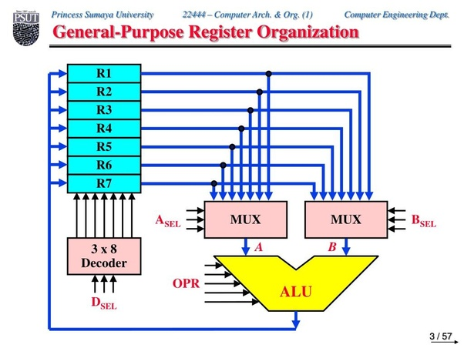
General Register organization
Generally CPU has seven general registers. Register organization show how registers are selected and how data flow between register and ALU.
A decoder is used to select a 3 particular register.
The output of each register is connected to two multiplexers to form the two buses A and B.
The selection lines in each multiplexer select the input data for the particular bus.
The A and B buses form the two inputs of an ALU.
The operation select lines decide the micro operation to be performed by ALU.
The result of the micro operation is available at the output bus.
The output bus connected to the inputs of all registers, thus by selecting a destination register it is possible to store the result in it .

Slide 18
EXAMPLE:
• To perform the operation R3 = R1+R2 we have to provide following binary selection variable to the select
inputs.
1. SEL A: 001 -To place the contents of R1 into bus A.
2. SEL B: 010 - to place the contents of R2 into bus B
3. SEL OPR: 10010 – to perform the arithmetic addition A+B
4. SEL REG or SEL D: 011 – to place the result available on output bus in R3

Slide 19
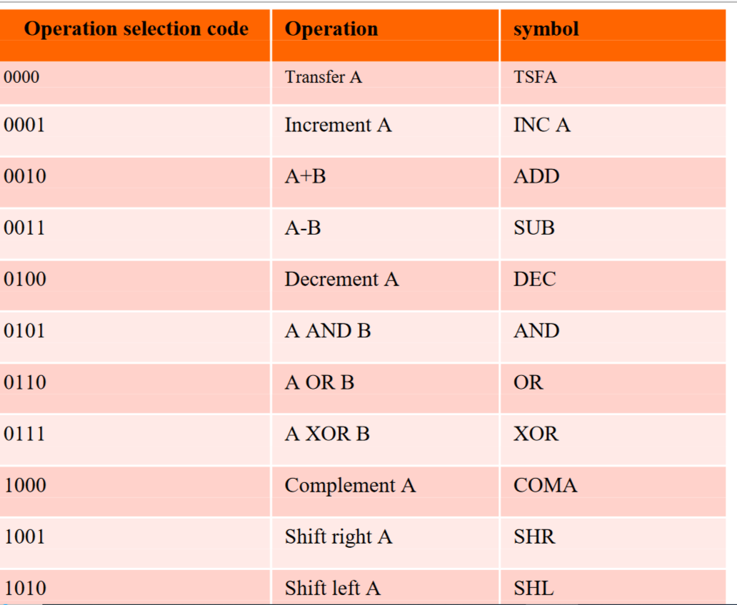
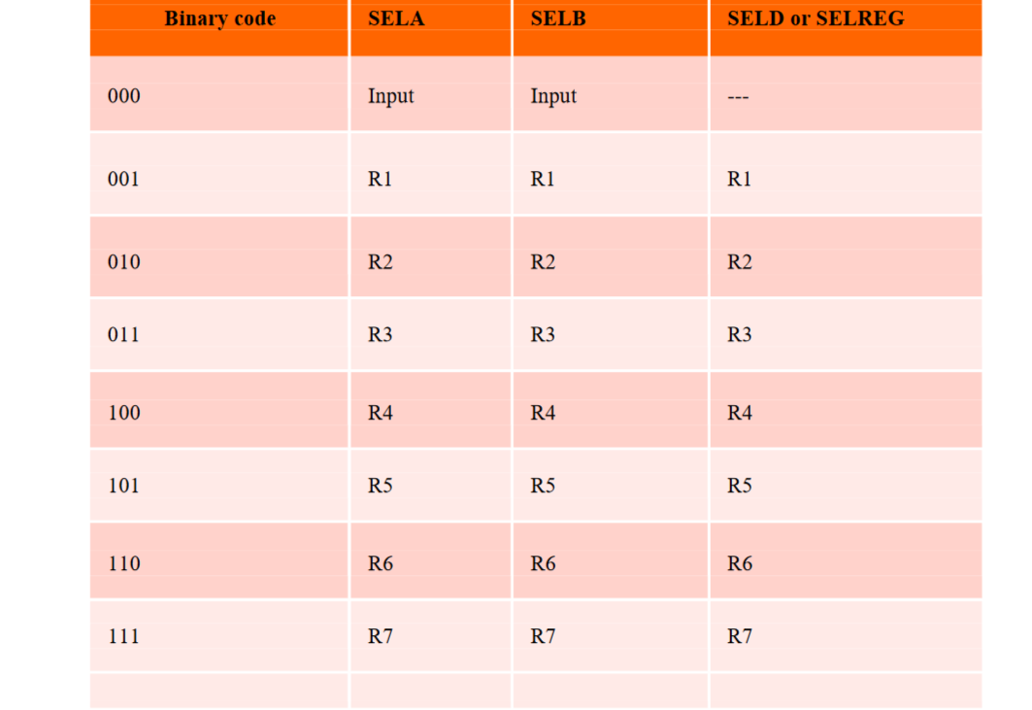
Register and multiplexer input selection code
Operation with symbol

Slide 20
What is CONTROL WORD?
The combined value of a binary selection inputs specifies the control word.
• It consists of four fields SELA, SELB, and SELD or SELREG contains three bit each and
SELOPR field contains four bits thus the total bits in the control word are 13-bits.
FORMATE OF CONTROL WORD
1. The three bit of SELA select a source registers of the input of the ALU.
2. The three bits of SELB select a source registers of the b input of the ALU.
3. The three bits of SELED or SELREG select a destination register using the decoder.
4. The four bits of SELOPR select the operation to be performed by ALU
SEL A | SELB | SELD or SELREG | SELOPR

Slide 21
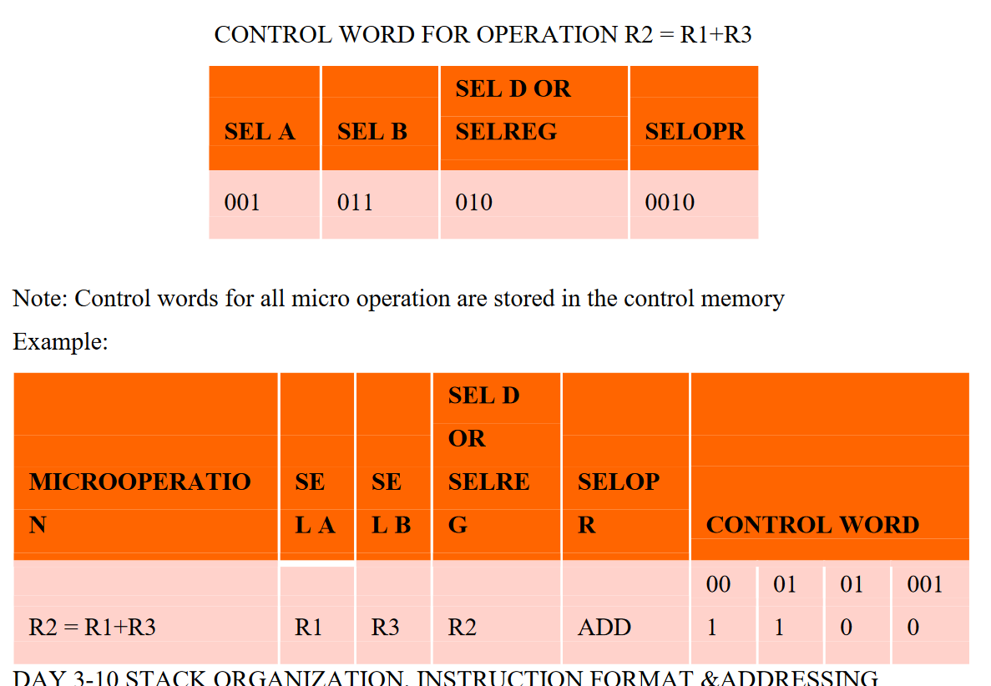

Slide 22
STACK ORGANIZATION
Stack is a storage structure that stores information in such a way that the last item stored is the first item retrieved.
It is based on the principle of LIFO (Last-in-first-out).
The stack in digital computers is a group of memory locations with a register that holds the address of top of element.
This register that holds the address of top of element of the stack is called Stack
Pointer.
Stack Operations
The two operations of a stack are:
1. Push: Inserts an item on top of stack.
2. Pop: Deletes an item from top of stack.
Implementation of Stack In digital computers, stack can be implemented in two ways:
1. Register Stack
2. Memory Stack

Slide 23
Register Stack
A stack can be organized as a collection of finite number of registers that are used to store temporary information during the execution of a program.
The stack pointer (SP) is a register that holds the address of top of element of the stack.
Memory Stack
A stack can be implemented in a random access memory (RAM) attached to a CPU.
The implementation of a stack in the CPU is done by assigning a portion of memory to a stack operation and using a processor register as a stack pointer.
The starting memory location of the stack is specified by the processor register as stack pointer

Slide 24
INSTRUCTION FORMATS
The physical and logical structure of computers is normally described in reference manuals provided with the system.
Such manuals explain the internal construction of the CPU, including the processor registers available and their logical capabilities.
The most common fields found in instruction formats are:
1. An operation code field that specifies the operation to be performed.
2. An address field that designates a memory address or a processor registers.
3. A mode field that specifies the way the operand or the effective address is determine

Slide 25
Computers may have instructions of several different lengths containing varying number of addresses.
The number of address fields in the instruction format of a computer depends on
the internal organization of its registers.
Most computers fall into one of three types of CPU organizations:
1 Single accumulator organization.
2 General register organization.
3 Stack organization

Slide 26
THREE-ADDRESS INSTRUCTIONS
Computers with three-address instruction formats can use each address field to specify either a processor register or a memory operand.
The program in assembly language that evaluates X = (A + B) ∗ (C + D) is shown below, together with comments that explain the register transfer operation of each instruction.
ADD R1, A, B R1 ← M [A] + M [B]
ADD R2, C, D R2 ← M [C] + M [D]
MUL X, R1, R2 M [X] ← R1 ∗ R2
It is assumed that the computer has two processor registers, R1 and R2.
The symbol M [A] denotes the operand at memory address symbolized by A.

Slide 27
TWO-ADDRESS INSTRUCTIONS
Two address instructions are the most common in commercial computers. Here again each
address field can specify either a processor register or a memory word. The program to
evaluate X = (A + B) ∗ (C + D) is as follows:
MOV R1, A R1 ← M [A]
ADD R1, B R1 ← R1 + M [B]
MOV R2, C R2 ← M [C]
ADD R2, D R2 ← R2 + M [D]
MUL R1, R2 R1 ← R1∗ R2
MOV X, R1 M [X] ← R1
The MOV instruction moves or transfers the operands to and from memory and processor registers.
The first symbol listed in an instruction is assumed to be both a source and the destination where the result of the operation is transferred.

Slide 28
ONE-ADDRESS INSTRUCTIONS
One-address instructions use an implied accumulator (AC) register for all data manipulation.
For multiplication and division there is a need for a second register. However, here we will
neglect the second and assume that the AC contains the result of tall operations. The program
to evaluate X = (A + B) ∗ (C + D) is
LOAD A AC ← M [A]
ADD B AC ← A [C] + M [B]
STORE T M [T] ← AC
LOAD C AC ← M [C]
ADD D AC ← AC + M [D]
MUL T AC ← AC ∗ M [T]
STORE X M [X] ← AC
All operations are done between the AC register and a memory operand. T is the address of a
temporary memory location required for storing the intermediate result.

Slide 29
ZERO-ADDRESS INSTRUCTIONS
A stack-organized computer does not use an address field for the instructions ADD and
MUL. The PUSH and POP instructions, however, need an address field to specify the
operand that communicates with the stack. The following program shows how X = (A + B) ∗
(C + D) will be written for a stack organized computer. (TOS stands for top of stack)
PUSH A TOS ← A
PUSH B TOS ← B
ADD TOS ← (A + B)
PUSH C TOS ← C
PUSH D TOS ← D
ADD TOS ← (C + D)
MUL TOS ← (C + D) ∗ (A + B)
POP X M [X] ← TOS
To evaluate arithmetic expressions in a stack computer, it is necessary to convert the
expression into reverse Polish notation.
The name “zero-address” is given to this type of computer because of the absence of an address field in the computational instructions.

